Slide 1
Natural Narrative Generation from Structured Data
Daljeet Virdi (dvirdi2)
Dileep Pasumarthi (dileepp2)
Gowri Shankar Ramanan (gsr2)

Slide 2
Problem Statement
Given time series data, compute insights and intelligence and return them as a coherent natural language narration.
The input is time series data.
The output is a paragraph or two of text.
We focus on financial data for this project.
We explore Few Shot NLG (a neural based natural language generation) for this project.

Slide 3
Example
The input will be weekly time series data
The output is a paragraph or two of text
"That is an average decrement of $2.17 comparative to past month! Not good.Apple had the shortest stock price with $105.44.And the average this period of time is more or less $111.13, give or take 19.24.The awaited average stock cost for Apple in the expected month is $108.96!."
Stock | Min | Max | Avg | Variance | Company | Domain | Sub Domain | HQ | Week Start Date
MSFT | 57.94 | 57.67 | 58.17 | 0.03 | Microsoft | Information Technology | Systems Software | Redmond Washington | 26-Aug-16
AAPL | 109.71 | 107.79 | 111.06 | 2.25 | Apple | Information Technology | Computer Hardware | Cupertino California | 11-Nov-16

Slide 4

NLG Architecture
An NLG system usually involves three processes:
Content determination - what you’re going to say, based on knowledge, communicative goal and user’s expectations
Sentence planning – how are you going to say it. Remember, semantically sane!
Surface realization – the final output, which specific words to use, do sentences follow each other nicely and so on. You could call this style or flow.

Slide 5
Training data for NLG
To build our training data, we took publicly available New York Stock Exchange data.
It contains historical prices for S&P 500 companies with fundamental data.
We filtered the data for Microsoft and Apple, converted daily time series to weekly time series, split it to train-test-valid sets.
We used PySpark (on Azure Databricks) to aggregate and analyze the data.
Spark is used only for data wrangling and is not the core component of this project. So we skip installation instructions. We expect TAs to work processed input.

Slide 6
Demo for Data Prep - PySpark

Slide 7
Templatized Summaries
Training NLG module requires summaries.
As there are no annotated datasets available we built python module to generate summaries.
We wrote templatized summaries about these metrics using Simple NLG and Datamuse API.
Simple NLG: It is used as "realization engine" for NLG architecture.
Datamuse: It is a word-finding query engine which can find words that match a given set of constraints.
Both of these packages are useful to add variations to templatized summaries.

Slide 8
Demo for Templatized Summaries

Slide 9
Few Shot NLG
Few Shot NLG is neural based natural language generation.
The design of this model architecture is based on
Content selection or copying from input data
Language modeling to compose coherent sentences
We use a pre-trained domain independent language model, in this case, GPT-2, and train it to copy and select content based on a few training examples.
With just ~200 - 400 training examples it can produce reasonable summaries.

Slide 10
Demo – Few Shot NLG

Slide 11
Installation - Templatized Summaries
Repo Link: https://lab.textdata.org/dileepp2/Course_Project
Run './dev.sh' - it should install all the required packages
Run 'CS410_Stock_Narrator.ipynb' - it is a jupyter notebook.
This notebook takes "export.csv" as input
It generates "input.txt" and "summary.txt" as outputs
These are then split into train-test-valid using Spark.
Running entire notebook should take ~ 5mins to complete.

Slide 12
Installation - Few Shot NLG and limitations
Readme is included in /Few-Shot-NLG/ @ https://lab.textdata.org/dileepp2/Course_Project
Run ./build-cloud.sh to build a VM with a GPU on Google Cloud
Run ./box.sh on the VM to pull the code, data, and models and start the algorithm
To see output go to ~/Output
It takes ~2 days to complete 2000 epochs on a 128GB RAM and 2 Tesla GPUs
Note: It took a while to run the code. As with most papers and research, the code is specific to a specific OS, python version, etc. This was no difference. We tried running it on our computers, windows, debian, etc. It only worked on Ubuntu, Python 3.6, with an Nvidia GPU. We configured the machine we needed on google cloud.

Slide 13
Results
Training data
symbol_1:AAPL startts_1:16_Sep_2016 endts_1:23_Sep_2016 currperiodavg_1:111.13 currperiodmin_1:105.44 currperiodmax_1:115.57 currperiodvar_1:19.24 numericunits_1:$ company_1:Apple hq_1:Cupertino__California domain_1:Information_Technology domain_2:( domain_3:Computer_Hardware domain_4:) symbol_2:AAPL startts_2:07_Oct_2016 endts_2:14_Oct_2016 currperiodavg_2:113.3 currperiodmin_2:112.52 currperiodmax_2:114.06 currperiodvar_2:0.42 numericunits_2:$ company_2:Apple hq_2:Cupertino__California domain_1:Information_Technology domain_2:( domain_3:Computer_Hardware domain_4:)
Training Data Summary
That is an average decrement of $2.17 comparative to past month! Not good.Apple had the shortest stock price with $105.44.And the average this period of time is more or less $111.13, give or take 19.24.The awaited average stock cost for Apple in the expected month is $108.96!.
50th epoch Summary
Apple had the top stock value with $115.57.Apple Averages were 111 this quarter..Interested to know more?. Here is some Averages slue to empathize!.Apple Averages were 111 this quarter..
700th epoch Summary
That is an average decline of $1.67 relative to past month! That is an average diminish of $1.03 compared to past month! Not good. Apple had the least stock price with $105.44.
As you might notice, the synonyms we used to train it got in way. This is why having human annotated training data is important.

Slide 14
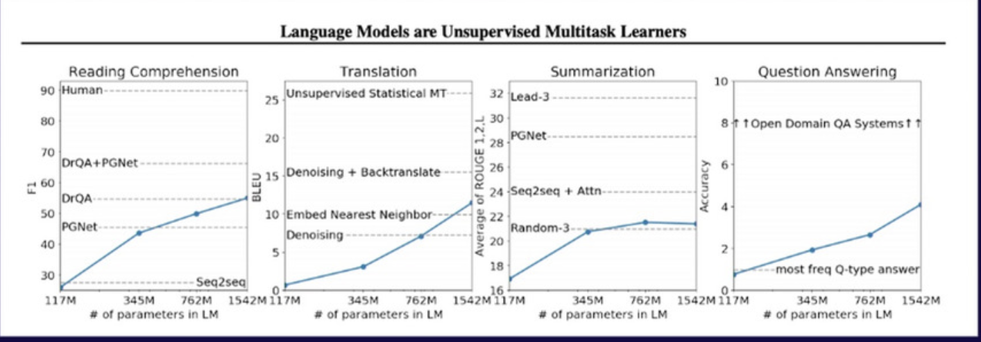
Future work
There are number of other techniques/approaches we would like to try
Using Amazon Mechanical Turk (a crowd sourcing tool) to help build human annotated data instead of using templates.
Current GPT-2 model uses 117M params. There is an updated GPT-2 model with 771M params. We would like to use update GPT-2 model.
There are other industry leading algorithms for NLG. See below (blue line is Few Shot NLG)

Slide 15
References
[1]https://www.bluewolf.com/bluewolf-now/future-retail-weather-insights-qa-ibms-paul-walsh
[2]https://www.earthnetworks.com/blog/5-key-insights-from-our-airport-weather-report-view-infographic/
[3]https://enterprise.foursquare.com/intersections/article/summer-weather-data-reveals-consumer-insights
[4] https://github.com/rikdz/GraphWriter
[5] https://arxiv.org/pdf/1707.08052.pdf
[6] https://arxiv.org/pdf/1706.09254.pdf
[7] https://web.stanford.edu/class/cs224n/slides/cs224n-2019-lecture15-nlg.pdf
[8] http://www.visionandlanguage.net/workshop2019/
[9] https://medium.com/@samim/generating-stories-about-images-d163ba41e4ed
[10] http://www.visionandlanguage.net/workshop2019/program.html
[11] https://arxiv.org/abs/1904.09521
[12] https://github.com/ratishsp/data2text-plan-py
[13]https://www.youtube.com/watch?v=3oEb_fFmPnY&list=PLtmWHNX-gukKocXQOkQjuVxglSDYWsSh9&index=14
[14] https://github.com/fastai/course-nlp/blob/master/7b-seq2seq-nucleus.ipynb
[15] https://github.com/jitta/Natural-Language-Generation

